Slide 1
Tele-rehabilitation Gaming Therapy
Final Report
Group 15: Kevin Lind, Jayce Holley & Peter Zhu
Presenter: Jayce Holley
12/3/2012

Slide 2
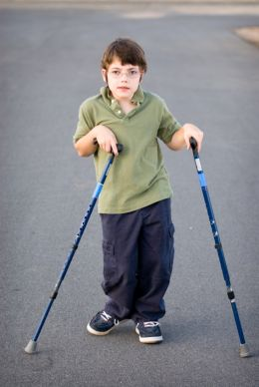
Cerebral Palsy
Cerebral Palsy
#1 Cause of Physical Disability
Affects 2-3 births per 1000 children
Core of the Problem: Spasticity
Major Takeaway: Muscle Strength not related to Spasticity

Slide 3
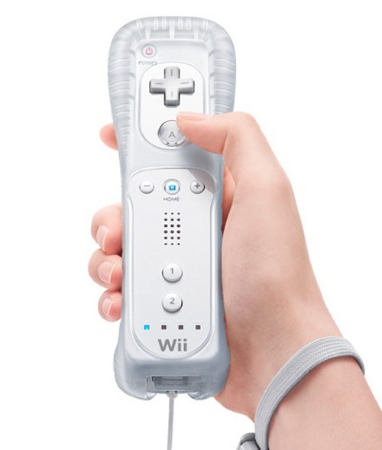
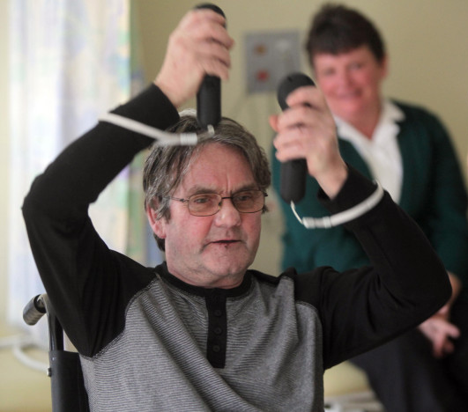
Tele-rehabilitation
Tele-rehabilitation
Increase motivation Increase Repetition
How?
97% of American Children Play Video Games

Slide 4
Requirements
Tele-Kit
Cheap
Quick & Easy Setup
Laptop
Wi-Fi Hotspot
Wii-Remote
Webcam
Appropriate Resolution 640X480
Tele-Process
Quality Resolution for face timing
Quick Setup
Troubleshooting Capabilities
Game Modification
Knee Rehab Device
Cheap (< $200)
Light Weight (< 30 lb.)
Reasonably Sized (fit in 2 ft. x 2 ft. x 2 ft. box)
Wii remote port
Variable Resistance
Range of Motion (0<θ<90)
Must integrate with pre-existing base

Slide 5
The Hardware

Slide 6
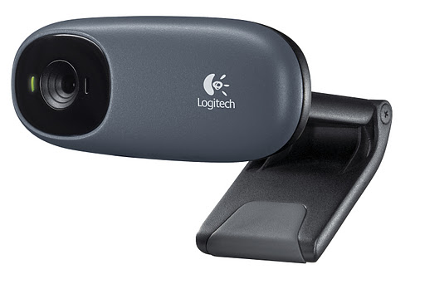
Tele-Kit Solution
Laptop
Solution: Dell Latitude E6400
Cheap: $279.99
Fits hardware requirements:
2.4 GHz processor
2 GB RAM
80 GB Hard Drive
Webcam
Solution: Logitech C110
Cheap: $18.32
HD Resolution: 1024x768
Contains Microphone
Notes:
Laptop: http://cdn.asia.cnet.com/i/r/2008/nb/43888809/sc001.jpg
Webcam: https://lh3.googleusercontent.com/-7kfS3IMofO8/Ts0smoxvU7I/AAAAAAAAJKo/CgmtZskppbA/C110%252520grey_CTG1.jpg

Slide 7
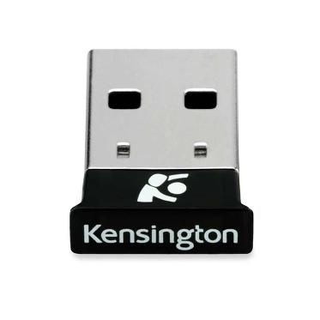
Tele-Kit Solution
Bluetooth Dongle
Solution: Kensington USB Micro-adaptor
USB 2.0
Data Transfer: 3.0 Mbps
Range: 10 m
Price: $16.18
Wi-Fi Hotspot
Solution: Verizon Wireless 4G LTE USB Modem
Cost: $52.99
Doesn’t Require Data Plan
Patient Can Opt out if they have Internet
Verizon Coverage
Notes:
Dongle: http://qph.cf.quoracdn.net/main-qimg-8c501eaebb0b4d58d8806d244e9dd0d6
Hotspot:

Slide 8
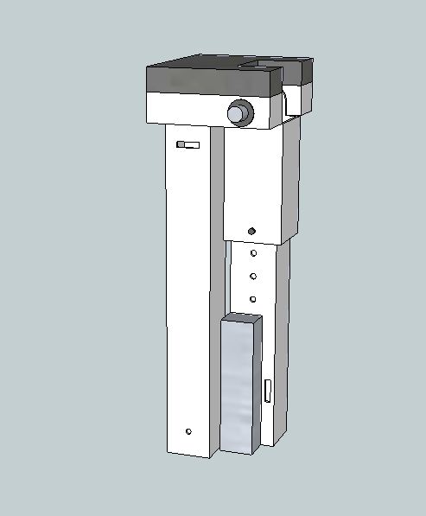
Knee Rehabilitation Device
Seven Primary Components
Base
Base Attachment Arm
Thigh Rest Plate
Upper Rotating Arm
Lower Rotating Arm
Pivot System
Thera-Band Resistance
Notes:
Torsional Spring: http://best-b2b.com/userimg/896/898-1/torsion-spring-125.jpg

Slide 9
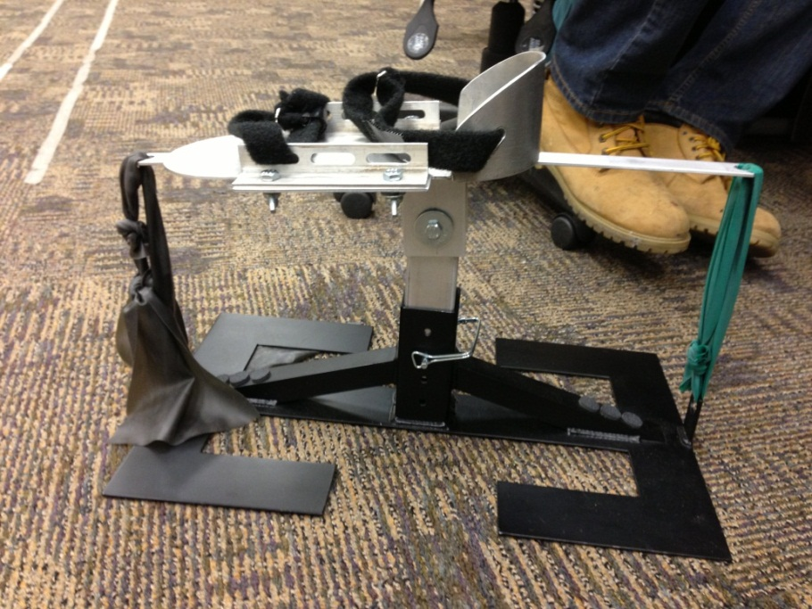
Base
Developed by Dr. Engsberg’s team in 2011
Ankle Rehabilitation Device
Steel
Four holes – height adjustable
Steel Locking Pin
Base Post
2.5” x 2.5” x 5”

Slide 10
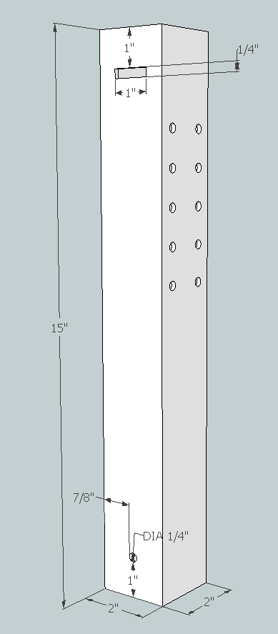
Base Attachment Arm
Specifications:
Aluminum Tube (Alloy 6061)
1/8” Wall Thickness
2” x 2”x 15”
Features:
¼” Hole – Connect To Base
1” x ¼” Slot – Securing Straps
5 Pairs of Holes for U-Bolt (Thera-Band Anchor)

Slide 11
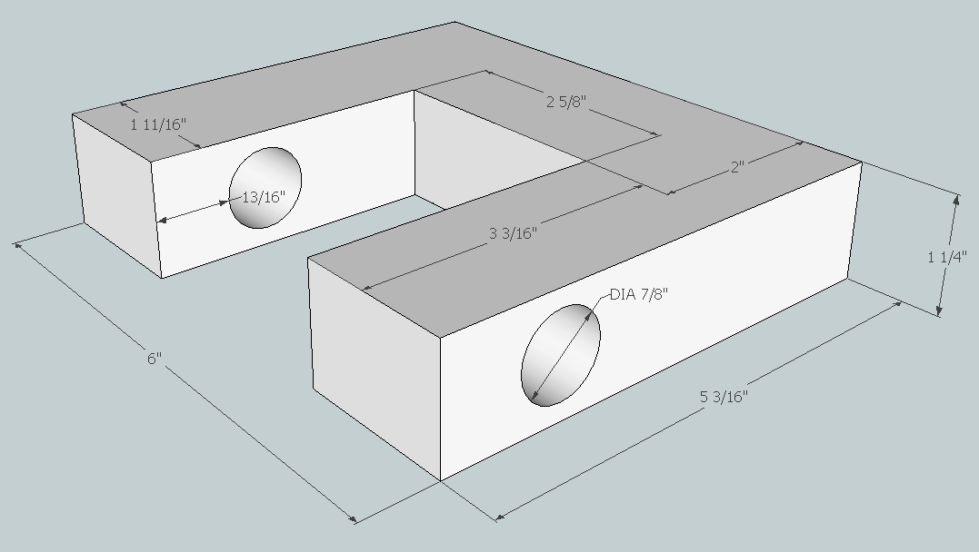
Thigh Rest Plate
Specifications:
Aluminum Sheet (Alloy 6061)
1 ¼” Thick
Supports Patient’s Thigh
6” x 5 3/16”
Features:
Two 7/8” Dia. Holes for Axel
1” Thick Foam Padding for Comfort

Slide 12
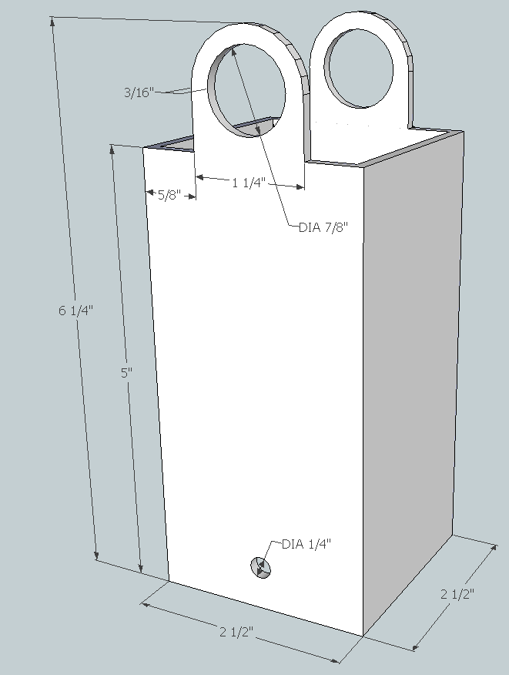
Upper Rotating Arm
Specifications:
Aluminum Tube (Alloy 6061)
1/8” Wall Thickness
2 ½” x 2 ½” x 6 ¼”
Features:
Two 7/8” Dia. Holes for Axel
Two ¼” Dia. Holes for Telescoping Lower Arm
Square Retaining Pin

Slide 13
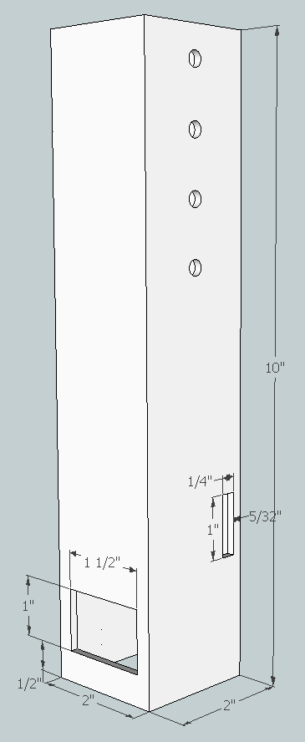
Lower Rotating Arm
Specifications:
Aluminum Tube (Alloy 6061)
1/8” Wall Thickness
2” x 2” x 10”
Features:
Four Pairs of ¼” Holes
Telescoping Feature
Two 1” x ¼” Slits – Securing Strap
1” x 1 ½” cutout – one side only
Thera-Band Anchor

Slide 14
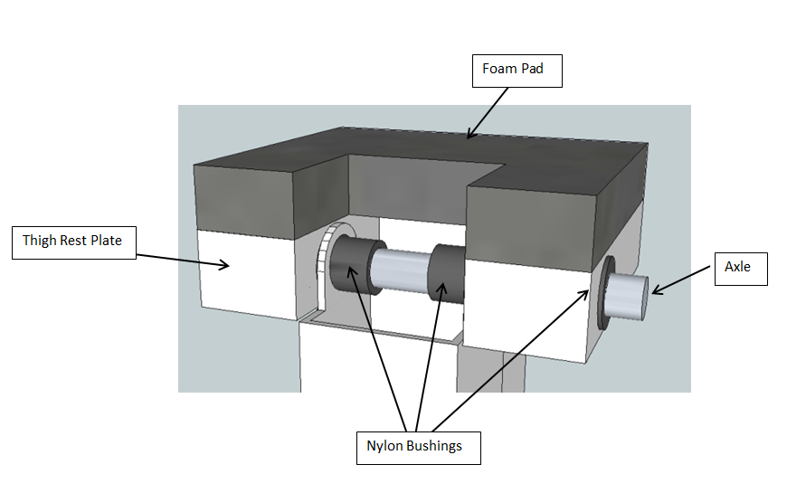
Pivot
Specifications:
Aluminum Axle (Alloy 6061)
Hard Anodized Coating
Resists Wear and Corrosion
5/8” Dia.
7” Long
Features:
Four Nylon Bushings
Minimize Friction
Secured With Two Clevis Pins

Slide 15
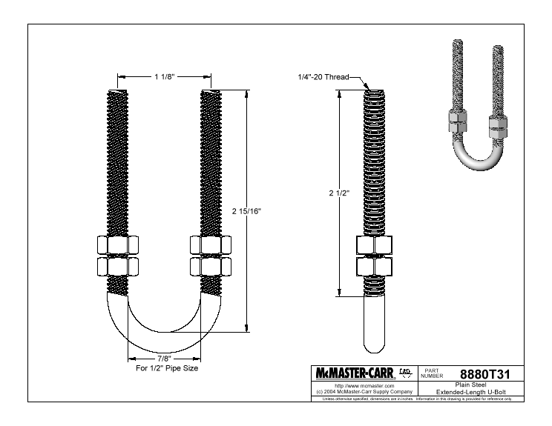
Thera-Band Connection
Specifications:
Steel(Alloy 6061)
1/4” Dia.
2 15/16” Long
Features:
Hole in Base Attachment Arm
Secured With 4 Hex Nuts
Therapist cuts bands to length
Ties both ends to U-Bolt
Forms a loop

Slide 16
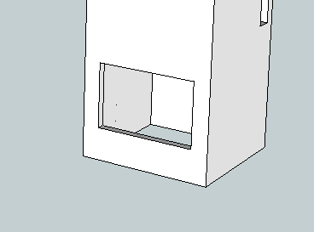
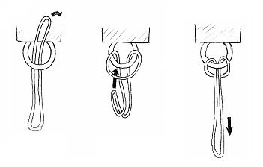
Thera-Band Cont.
Attaching The Thera-Bands:
Thera-Bands pre-tied to U-Bolt
Cutout - Lower Rotating Arm
Cow’s Hitch
2X Resistance of Single Band
Secure U-bolt

Slide 17
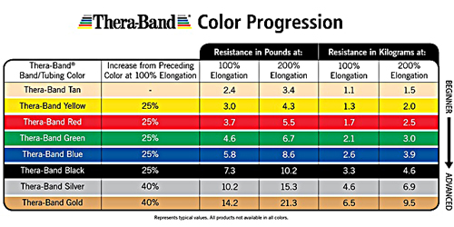
Resistance Values
Knee Torque: 39.4 Nm - 83.4 Nm
Thera-Band Tension Values: 23.01 kg – 108.9 kg

Slide 18
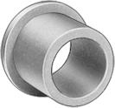
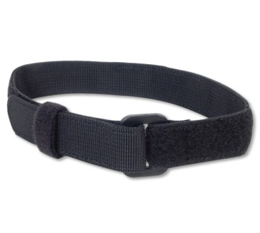
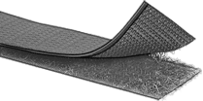
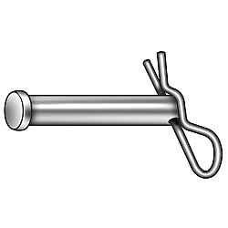
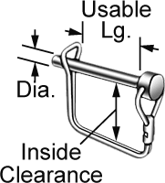
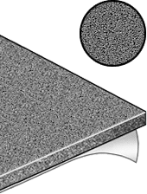
Additional Parts
Four Nylon Bushings
Two Velcro Securing Straps
36” – Lower Leg
48” – Thigh
Adhesive Velcro Straps
Wii-Remote and Foam
Two Clevis Pins
Secure Axle
Two Square Retainer Pins
Base and Telescoping Arm
Polyurethane Foam
Cushions Thigh Plate

Slide 19
Materials List
Part | Supplier | Part number | Dimensions | Material | Cost | No. orders Needed
Base Attachment Arm and Lower Rotating Arm | McMaster Carr | 6546K233 | 2” x 2” x 36” | Unpolished Aluminum Tube Alloy 6061 | $30.75 | 1
Thigh Rest Plate | McMaster Carr | 89155K972 | 6” x 6” x 1 ¼” | Unpolished Aluminum Sheet | $44.84 | 1
Foam Padding | McMaster Carr | 8643K513 | 12” x 12” x 1” | Super-Cushioning Polyurethane Foam | $8.76 | 1
U-Bolt (w/ 4 Hex Nuts) | McMaster Carr | 8880T31 | Usable Length- 2 15/16” Threaded Length-2 ½” | Extended Length Steel U-Bolt | $4.40 (pkg. of 5) | 2
Upper Rotating Arm | McMaster Carr | 6546K431 | 2.5” x 2.5” x 12” | Unpolished Aluminum Tube Alloy 6061 | $15.67 | 1
Locking Pins | McMaster Carr | 98416A009 | Dia.-1/4” Usable Lg.-2 ¼” O’All Lg.-2 13/16” | Locking Pin w/ Square Retainer (Zinc Plated Steel) | $2.12 | 2
Axle | McMaster Carr | 6750K171 | Dia.- 5/8” Lg.-12” | Hard Anodized Coating Aluminum Rod | $9.29 | 1
Axle Locking Pins | McMaster Carr | 92401A631 | Dia.–¼” Usable Lg.-3/4” O’all Lg.-1” | Stainless Steel Clevis Pins | $10.90 (pkg. of 5) | 1
Plastic Bushings | McMaster Carr | 6389K621 | Shaft Dia. – 5/8” OD – 7/8” Lg. – ¾” | Plastic Flanged Sleeve Bearings | $4.99 (pkg. of 5) | 1
Adhesive Velcro for Wii-Remote | McMaster Carr | 9273K14 | 1” wide 60” long | Adhesive Back Hook and Loop | $7.55 | 1
Lower Leg Securing Strap | McMaster Carr | 3955T72 | 1” wide 36” long | Super-Grip Black Nylon | $5.23 | 1
Thigh Securing Strap | McMaster Carr | 3955T75 | 1 “ wide 48” long | Super-Grip Black Nylon | $7.41 | 1
Total Cost: $158.43
Total Weight:
8.62 lbs.

Slide 20
Manufacturing
Machining
Weld Joint – Thigh Plate to Base Attachment Arm
Machining Holes, Slots, and Stock to Size
Cutting Foam and Velcro to Size
Local Trade School Could Provide Free Prototype Manufacture
Supplier
McMaster-Carr For All Parts
www.mcmaster.com
Lead Time of 7-10 Business Days

Slide 21
The Software

Slide 22
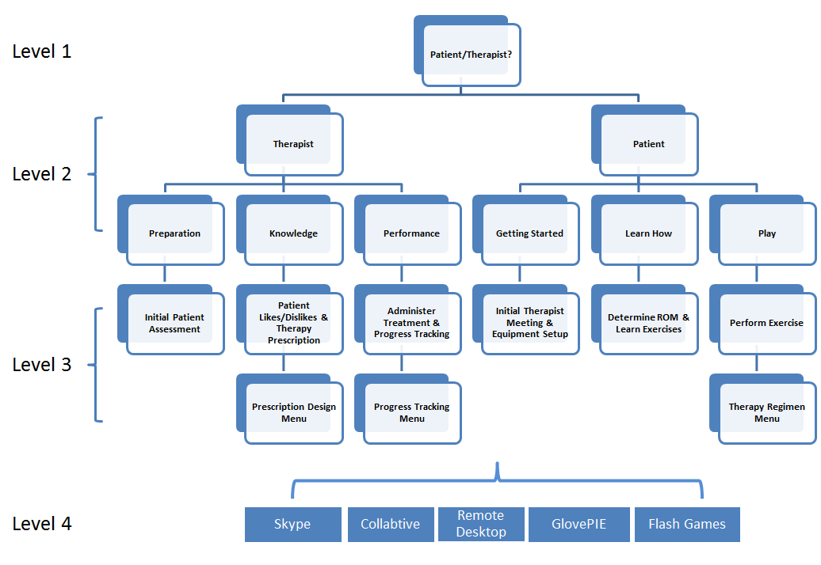
GUI Flowchart

Slide 23
Conclusions

Slide 24
Did We Solve the Problem?
Hardware:
Variable Resistance
Cost
Size & Weight
Software:
Narrowed Scope
Creation of Skeleton GUI
Remote Assessment
Progress Tracking
Range of Motion

Slide 25
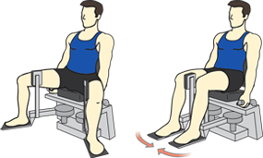
Looking Forward
Hardware:
Construction of the Prototype
Hip Rehabilitation
Software
Dr. Engsberg’s Grant
Microsoft Kinect

Slide 26
IP Considerations
Hardware:
Use of the Wii Remote
Software:
Open Source
Licensing

Slide 27
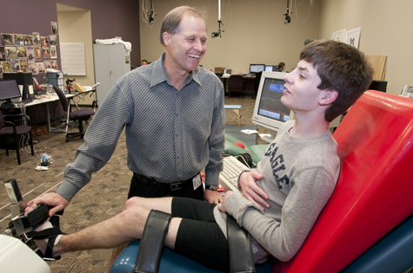
Lessons Learned
Client Focus First
Always Have a Backup Plan
Time Management

Slide 28
Questions?

Slide 29
References
Graham, H. Kerr, and P. Selber. "MUSCULOSKELETAL ASPECTS OF CEREBRAL PALSY." Royal Children's Hospital (n.d.): n. page. Print.
Engsberg, Jack R., and Sandy A. Ross. "Relation between Spasticity and Strength in Individuals with Spastic Diplegic Cerebral Palsy." Developmental Medicine & Child Neurology (2002): 149-57. Web.
Damiano, D., and M. F. Abel. "Functional Outcomes of Strength Training in Spastic Cerebral Palsy." Archives of Physical Medicine and Rehabilitation 79.2 (1998): 119-25. Print.
Dodd, K. J., N. F. Taylor, and D. L. Damiano. "A Systematic Review of the Effectiveness of Strength-training Programs for People with Cerebral Palsy." Archives of Physical Medicine and Rehabilitation 83.8 (2002): 1157-164. Print.
Deutsch, Judith E., Megan Borbely, Jenny Filler, Karen Huhn, and Phyllis Guarrera-Bowlby. "Use of a Low-Cost, Commercially Available Gaming Console (Wii) for Rehabilitation of an Adolescent with Cerebral Palsy." Journal of the American Physcial Therapy Association 88.10 (2008): 1196-207. Web. <http://ptjournal.apta.org/content/88/10/1196.full.pdf+html>.
Pew Internet & American Life Project Teens, Video Games and Civics http://pewresearch.org/pubs/953/ September 16, 2008
Kramer, John, and Ann MacPhail. "Relationships Among Measures of Walking Efficiency, Gross Motor Ability, and Isokinetic Strength In Adolescents With Cerebral Palsy." Pediatric Physical Therapy 6.1 (1994): n. pag. Web.

Slide 30
Figure References
Slide 2: http://trialx.com/curetalk/2011/12/cerebral-palsy-life-expectancy-treatments-clinical-trials/
Slide 3: http://o.aolcdn.com/dims/MOBL/5/760/560/50/http://www.blogcdn.com/www.engadget.com/media/2012/05/limbs-alive-1337395428.jpg & http://www.google.com/imgres?num=10&um=1&hl=en&client=firefox-a&rls=org.mozilla:en-US:official&channel=fflb&biw=1280&bih=880&tbm=isch&tbnid=Tg4LWUvd2NTXXM:&imgrefurl=http://gdgt.com/nintendo/wii/remote-controller/&docid=9V7s9AidXExMeM&imgurl=http://media.gdgt.com/img/product/23/hys/wii-remote-controller-1vah-460.jpg&w=460&h=345&ei=QO-NUKS-DKXWygHe5ICQDg&zoom=1&iact=hc&vpx=834&vpy=346&dur=667&hovh=194&hovw=259&tx=127&ty=89&sig=102601995692876487404&sqi=2&page=1&tbnh=142&tbnw=195&start=0&ndsp=31&ved=1t:429,r:10,s:0,i:165
Slide 4: http://stronger-slimmer.com/leg-extensions.jpg & http://www.google.com/imgres?um=1&hl=en&client=firefox-a&rls=org.mozilla:en-US:official&channel=fflb&biw=1280&bih=880&tbm=isch&tbnid=FQLEmUeljFUbaM:&imgrefurl=http://www.ehow.com/how_8287614_video-record-webcam-laptop.html&docid=3K_FjjTGcsZeIM&imgurl=http://img.ehowcdn.com/article-new/ehow/images/a07/st/bu/video-record-webcam-laptop-800x800.jpg&w=393&h=300&ei=rO-NUNitNKbUyQHKlYHABg&zoom=1&iact=hc&vpx=362&vpy=139&dur=176&hovh=196&hovw=257&tx=119&ty=65&sig=102601995692876487404&page=3&tbnh=135&tbnw=172&start=60&ndsp=36&ved=1t:429,r:53,s:20,i:299
Slide 7:http://cdn.asia.cnet.com/i/r/2008/nb/43888809/sc001.jpg & https://lh3.googleusercontent.com/-7kfS3IMofO8/Ts0smoxvU7I/AAAAAAAAJKo/CgmtZskppbA/C110%252520grey_CTG1.jpg
Slide 8: http://qph.cf.quoracdn.net/main-qimg-8c501eaebb0b4d58d8806d244e9dd0d6 & http://network4g.verizonwireless.com/
Slide 15: http://productimages.grainger.com/is/image/Grainger/1WFD4_AS01?$productdetail$
Slide 16: http://www.mcmaster.com/#cadinlnord/8880t31/=kfc703
Slide 17: http://www.thera-band.com
Slide 18: http://www.mcmaster.com

