Slide 1
Tele-rehabilitation Gaming Therapy
Progress Report
Group 15: Kevin Lind, Jayce Holley & Peter Zhu
Presenter: Kevin Lind
10/29/2012

Slide 2
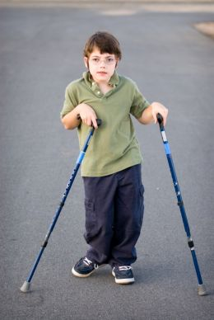
Cerebral Palsy
Cerebral Palsy
#1 Cause of Physical Disability
Affects 2-3 births per 1000 children
Core of the Problem: Spasticity
Major Takeaway: Muscle Strength not related to Spasticity

Slide 3
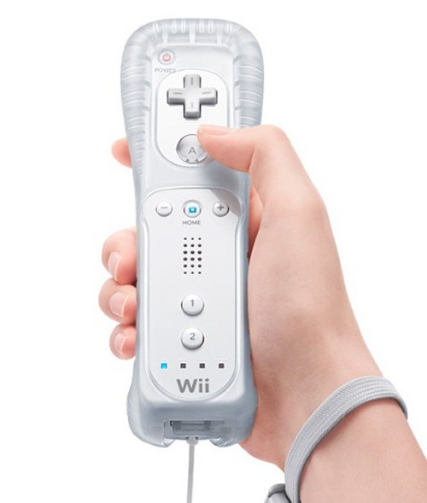
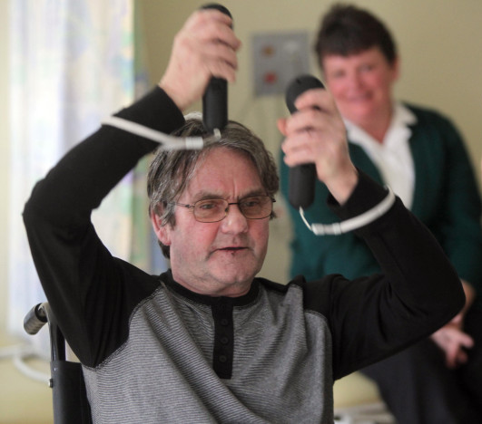
Tele-rehabilitation
Tele-rehabilitation
Increase motivation Increase Repetition
How?
97% of American Children Play Video Games

Slide 4
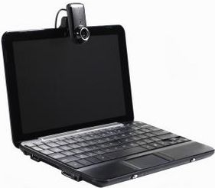
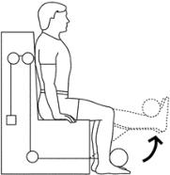
The Package
3 Parts:
Tele-Kit
Tele-Process
Knee Rehabilitation Device
Therapist
Patient

Slide 5
Requirements
Tele-Kit
Cheap
Quick & Easy Setup
Laptop
Wi-Fi Hotspot
Wii-Remote
Webcam
Appropriate Resolution 640X480
Tele-Process
Quality Resolution for face timing
Quick Setup
Troubleshooting Capabilities
Game Modification
Knee Rehab Device
Cheap (< $200)
Light Weight (< 30 lb.)
Reasonably Sized (fit in 2 ft. x 2 ft. x 2 ft. box)
Wii remote port
Variable Resistance
Range of Motion (0<θ<90)

Slide 6
The Hardware Alternatives

Slide 7
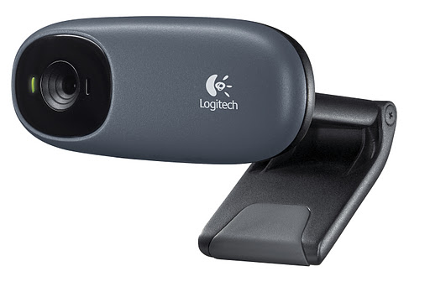
Tele-Kit Solution
Laptop
Solution: Dell Latitude E6400
Cheap: $279.99
Fits hardware requirements:
2.4 GHz processor
2 GB RAM
80 GB Hard Drive
Webcam
Solution: Logitech C110
Cheap: $18.32
HD Resolution: 1024x768
Contains Microphone
Notes:
Laptop: http://cdn.asia.cnet.com/i/r/2008/nb/43888809/sc001.jpg
Webcam: https://lh3.googleusercontent.com/-7kfS3IMofO8/Ts0smoxvU7I/AAAAAAAAJKo/CgmtZskppbA/C110%252520grey_CTG1.jpg

Slide 8
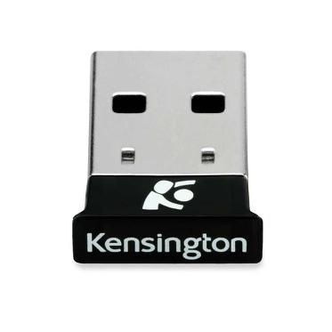
Tele-Kit Solution
Bluetooth Dongle
Solution: Kensington USB Micro-adaptor
USB 2.0
Data Transfer: 3.0 Mbps
Range: 10 m
Price: $16.18
Wi-Fi Hotspot
Solution: Verizon Wireless 4G LTE USB Modem
Cost: $52.99
Doesn’t Require Data Plan
Patient Can Opt out if they have Internet
Verizon Coverage
Notes:
Dongle: http://qph.cf.quoracdn.net/main-qimg-8c501eaebb0b4d58d8806d244e9dd0d6
Hotspot:

Slide 9
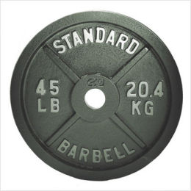
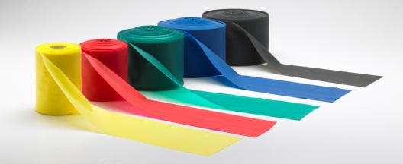
List of Hardware Solutions
Extension Spring
Torsional Spring
Damper
Weight System
Pulley System
Thera-Bands
Notes:
Torsional Spring: http://best-b2b.com/userimg/896/898-1/torsion-spring-125.jpg

Slide 10
Option 1 – Damper
Pros:
Safe
Don’t Store Potential Energy
Variable Resistance
Durable
Optional flexional resistance
Cons:
Velocity Dependent
Expensive
Price Range: 100+ for variable resistance
Therapist Familiarity

Slide 11
Option 2 – Extension Spring
Pros:
Cheap
Price Range: $1-$7
Small in Size
Light weight
Optional flexional resistance
Cons:
Safety Issues
Variable Resistance
Spring Entanglement
Therapist Familiarity/ Ideal Resistance Calculation

Slide 12
Option 3 – Thera-Bands
Pros:
Cheap
Light weight
Small
Variable Resistance
Familiar with Therapists
Cons:
Potential Safety Hazards
Inability to resist flexion

Slide 13
Hardware Pugh Chart
 | Weighting Scale | Extension Spring | Torsional Spring | Damper | Weight | Pulley | Thera-Band
Cost | 10 | 8 | 5 | 6 | 4 | 6 | 9
Safety | 10 | 7 | 6 | 10 | 5 | 5 | 7
Variable Resistance | 10 | 8 | 6 | 9 | 9 | 8 | 10
Weight | 9 | 8 | 7 | 7 | 1 | 4 | 10
Size | 9 | 8 | 7 | 7 | 2 | 4 | 10
Setup | 8 | 8 | 5 | 8 | 9 | 3 | 8
Therapist Familiarity | 6 | 5 | 4 | 3 | 9 | 5 | 10
Durability | 5 | 8 | 8 | 8 | 10 | 8 | 8
Extension/Flexion | 3 | 7 | 8 | 10 | 0 | 6 | 5
Totals |  | 529 | 424 | 523 | 383 | 374 | 619

Slide 14
The Software Alternatives

Slide 15
External Software
Content Management System: Collabtive
Open Source
User Friendly Interface
Great for blogging and Patient/Therapist Communication
Milestone Management
Face-time Software: Skype
Free
Wide User Base
Familiar
Remote Access: Remote Desktop
Integrated with Computer
Well Tested
Wii Data Transformer: GlovePie
Library of Pre-written scripts

Slide 16
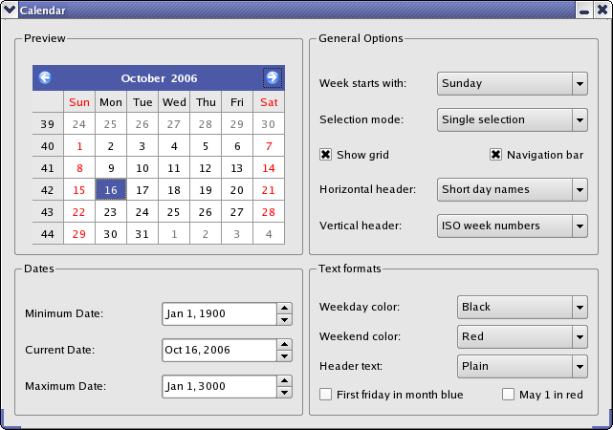
Option 1: C++ (Qt)
Pros:
Free
Aesthetics
Documentation
Design Flexibility
Cons:
No Client Experience
Ease of Creation
Example Qt GUI

Slide 17
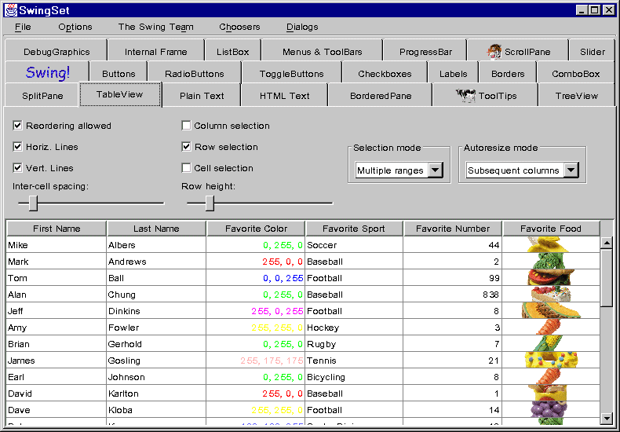
Option 2: Java (Swing)
Pros:
Free
Compatible
Data Manipulation
Customizability
Cons:
Minimal Client Familiarity
Slower than C++
Ease of Creation
Example Swing GUI

Slide 18
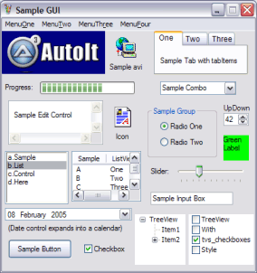
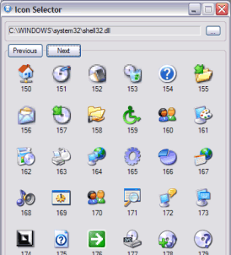
Option 3: AutoIt
Background:
BASIC coding language
Mainly used for process automation
Pros:
Free
User-Friendly
Aesthetics
Design Flexibility
Cons:
No Client Experience
Minimal Documentation
No Data Manipulation
AutoIt GUI Design
Notes:
http://www.autoitscript.com/site/autoit/

Slide 19
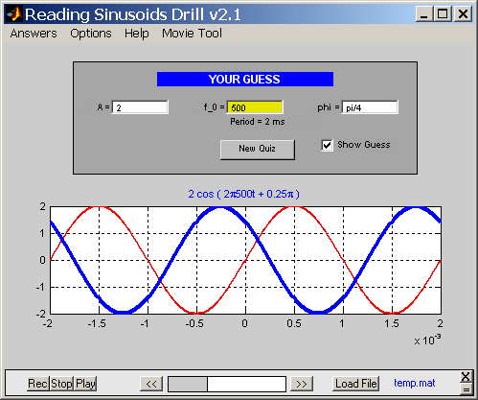
Option 4: Matlab
Pros:
Therapist Familiarity
Documentation Library
Ease of Creation
Data Manipulation
Cons:
Expensive
$100 student license
Compatibility
Example Matlab GUI
Notes:
http://users.ece.gatech.edu/mcclella/matlabGUIs/CDMELE/images/sindrillMovie.png

Slide 20
Graphic User Interface (GUI) Creation
 | Weight | Matlab | Java (Swing) | C++ (Qt) | AutoIt
Cost | 10 | 6 | 10 | 10 | 10
Client Familiarity | 10 | 10 | 6 | 0 | 0
Aesthetics | 7 | 7 | 8 | 10 | 9
Ease of Creation | 8 | 9 | 6 | 5 | 6
Compatibility | 7 | 7 | 9 | 9 | 6
Existing Documentation | 7 | 9 | 9 | 10 | 5
Data/Variable Manipulation | 10 | 10 | 8 | 8 | 5
Totals |  | 493 | 470 | 423 | 383

Slide 21
Design Details

Slide 22
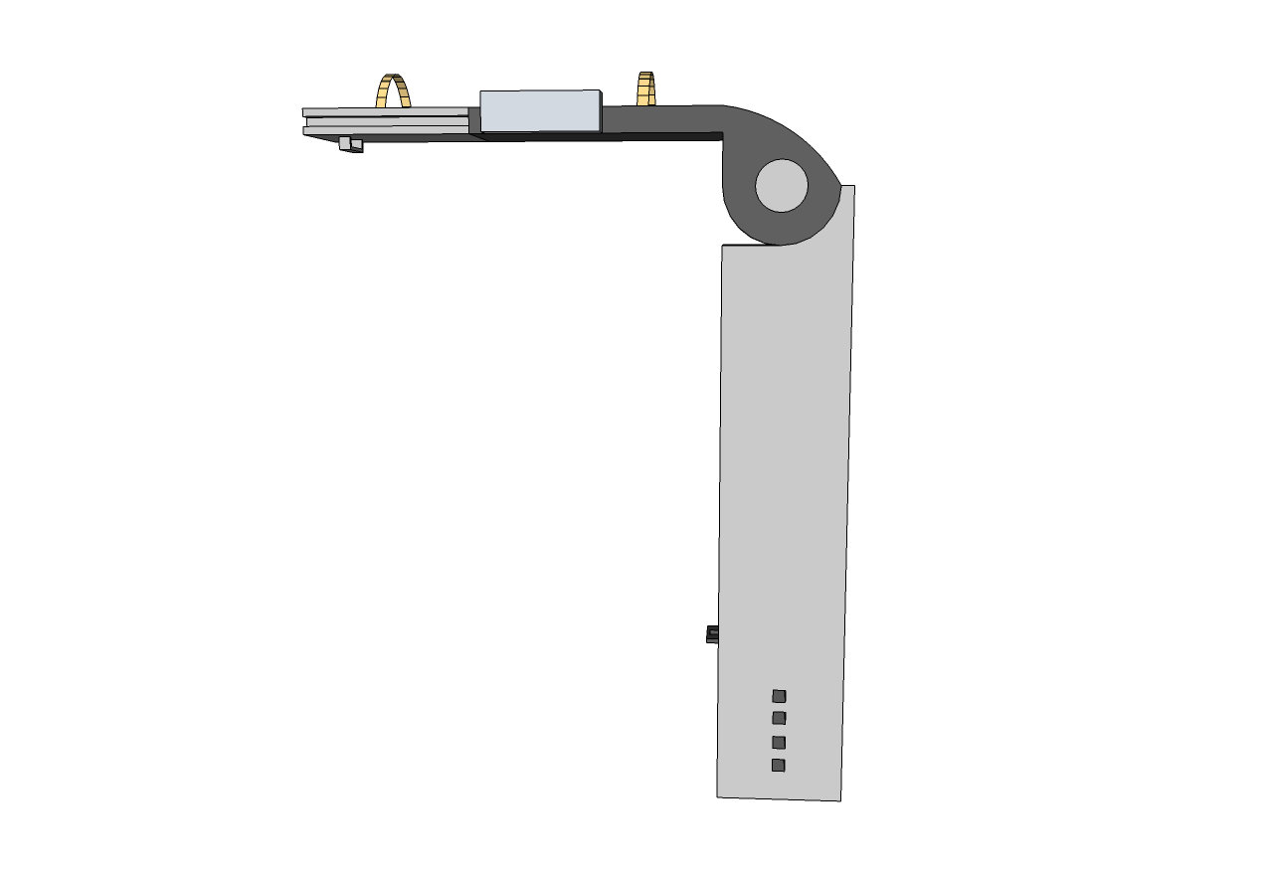
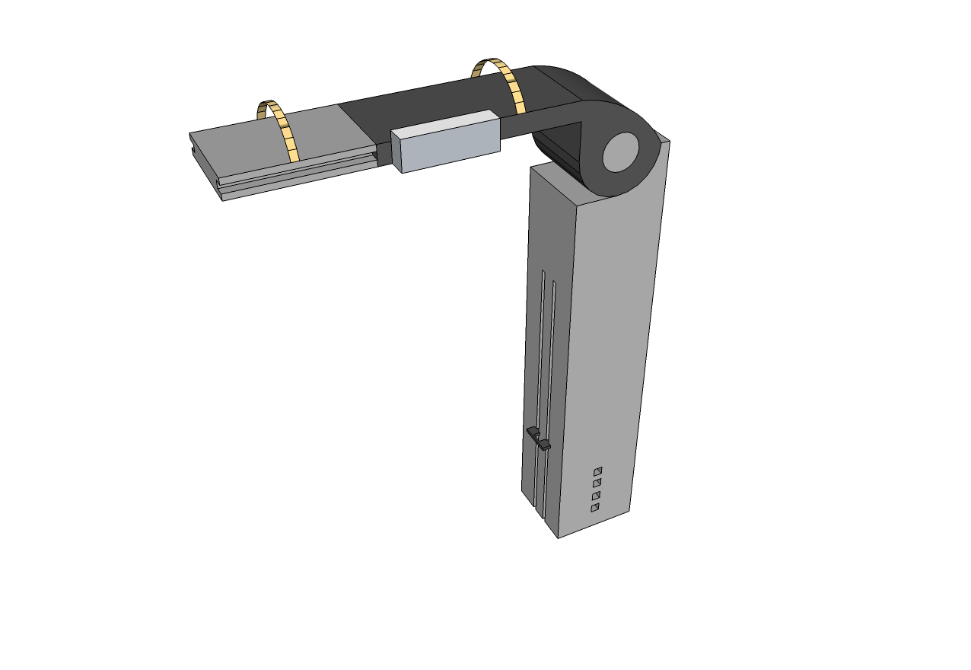
Mechanical Device
Wii Remote
Port
Telescoping Arm
Variable Height Adjustment
Variable Attachment Point

Slide 23
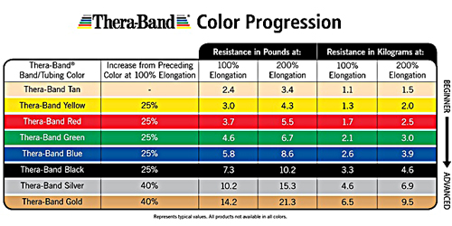
Thera-Bands
Cost, Size, Weight, Therapist Familiarity
Design Considerations:
Inability to provide resistance during flexion
Knee Flexor Strength not statistically correlated with gross motor ability (Kramer)
Notes:
http://users.ece.gatech.edu/mcclella/matlabGUIs/CDMELE/images/sindrillMovie.png

Slide 24
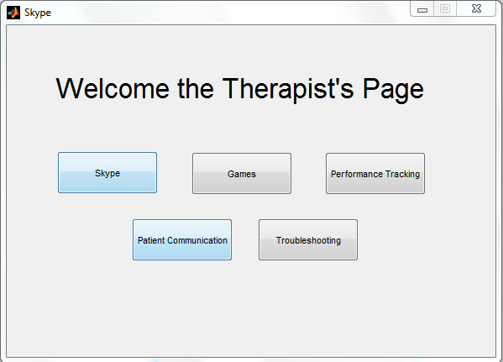
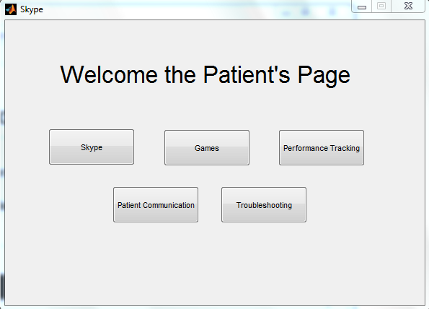
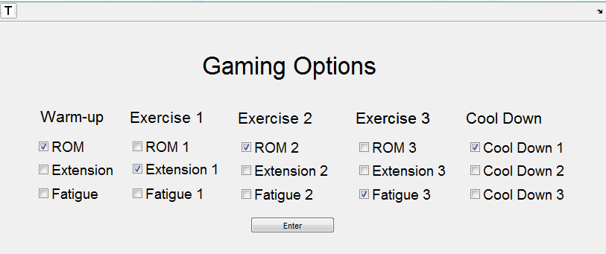
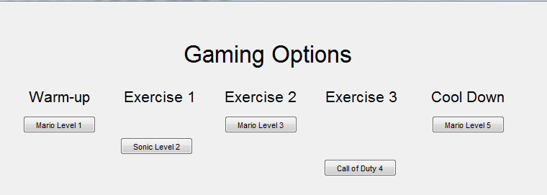
Matlab GUI

Slide 25
Design Schedule
Notes:
http://users.ece.gatech.edu/mcclella/matlabGUIs/CDMELE/images/sindrillMovie.png

Slide 26
Team Responsibilities
Notes:
http://users.ece.gatech.edu/mcclella/matlabGUIs/CDMELE/images/sindrillMovie.png

Slide 27
Questions?

Slide 28
References
Graham, H. Kerr, and P. Selber. "MUSCULOSKELETAL ASPECTS OF CEREBRAL PALSY." Royal Children's Hospital (n.d.): n. page. Print.
Engsberg, Jack R., and Sandy A. Ross. "Relation between Spasticity and Strength in Individuals with Spastic Diplegic Cerebral Palsy." Developmental Medicine & Child Neurology (2002): 149-57. Web.
Damiano, D., and M. F. Abel. "Functional Outcomes of Strength Training in Spastic Cerebral Palsy." Archives of Physical Medicine and Rehabilitation 79.2 (1998): 119-25. Print.
Dodd, K. J., N. F. Taylor, and D. L. Damiano. "A Systematic Review of the Effectiveness of Strength-training Programs for People with Cerebral Palsy." Archives of Physical Medicine and Rehabilitation 83.8 (2002): 1157-164. Print.
Deutsch, Judith E., Megan Borbely, Jenny Filler, Karen Huhn, and Phyllis Guarrera-Bowlby. "Use of a Low-Cost, Commercially Available Gaming Console (Wii) for Rehabilitation of an Adolescent with Cerebral Palsy." Journal of the American Physcial Therapy Association 88.10 (2008): 1196-207. Web. <http://ptjournal.apta.org/content/88/10/1196.full.pdf+html>.
Pew Internet & American Life Project Teens, Video Games and Civics http://pewresearch.org/pubs/953/ September 16, 2008
Kramer, John, and Ann MacPhail. "Relationships Among Measures of Walking Efficiency, Gross Motor Ability, and Isokinetic Strength In Adolescents With Cerebral Palsy." Pediatric Physical Therapy 6.1 (1994): n. pag. Web.

Slide 29
Figure References
Slide 2: http://trialx.com/curetalk/2011/12/cerebral-palsy-life-expectancy-treatments-clinical-trials/
Slide 3: http://o.aolcdn.com/dims/MOBL/5/760/560/50/http://www.blogcdn.com/www.engadget.com/media/2012/05/limbs-alive-1337395428.jpg & http://www.google.com/imgres?num=10&um=1&hl=en&client=firefox-a&rls=org.mozilla:en-US:official&channel=fflb&biw=1280&bih=880&tbm=isch&tbnid=Tg4LWUvd2NTXXM:&imgrefurl=http://gdgt.com/nintendo/wii/remote-controller/&docid=9V7s9AidXExMeM&imgurl=http://media.gdgt.com/img/product/23/hys/wii-remote-controller-1vah-460.jpg&w=460&h=345&ei=QO-NUKS-DKXWygHe5ICQDg&zoom=1&iact=hc&vpx=834&vpy=346&dur=667&hovh=194&hovw=259&tx=127&ty=89&sig=102601995692876487404&sqi=2&page=1&tbnh=142&tbnw=195&start=0&ndsp=31&ved=1t:429,r:10,s:0,i:165
Slide 4: http://stronger-slimmer.com/leg-extensions.jpg & http://www.google.com/imgres?um=1&hl=en&client=firefox-a&rls=org.mozilla:en-US:official&channel=fflb&biw=1280&bih=880&tbm=isch&tbnid=FQLEmUeljFUbaM:&imgrefurl=http://www.ehow.com/how_8287614_video-record-webcam-laptop.html&docid=3K_FjjTGcsZeIM&imgurl=http://img.ehowcdn.com/article-new/ehow/images/a07/st/bu/video-record-webcam-laptop-800x800.jpg&w=393&h=300&ei=rO-NUNitNKbUyQHKlYHABg&zoom=1&iact=hc&vpx=362&vpy=139&dur=176&hovh=196&hovw=257&tx=119&ty=65&sig=102601995692876487404&page=3&tbnh=135&tbnw=172&start=60&ndsp=36&ved=1t:429,r:53,s:20,i:299
Slide 7:http://cdn.asia.cnet.com/i/r/2008/nb/43888809/sc001.jpg & https://lh3.googleusercontent.com/-7kfS3IMofO8/Ts0smoxvU7I/AAAAAAAAJKo/CgmtZskppbA/C110%252520grey_CTG1.jpg
Slide 8: http://qph.cf.quoracdn.net/main-qimg-8c501eaebb0b4d58d8806d244e9dd0d6 & http://network4g.verizonwireless.com/
Slide 9: http://www.thera-band.com/UserFiles/Rolls_web3.jpg & http://best-b2b.com/userimg/896/898-1/torsion-spring-125.jpg & http://www.injectionmoldingonline.com/Images/springdashpot.bmp & http://i.pgcdn.com/pi/80/95/28/809528881_260.jpg
Slide 16: http://qt.developpez.com/doc/4.6/images/calendarwidgetexample.png
Slide 17: http://www.apl.jhu.edu/~hall/java/Swing-Tutorial/SwingSet-Windows-LAF.gif
Slide 18: http://www.autoitscript.com/site/autoit/\
Slide 19: http://users.ece.gatech.edu/mcclella/matlabGUIs/CDMELE/images/sindrillMovie.png

